Slide 1
Assignment 5
Xiaoyan Zhang

Slide 2
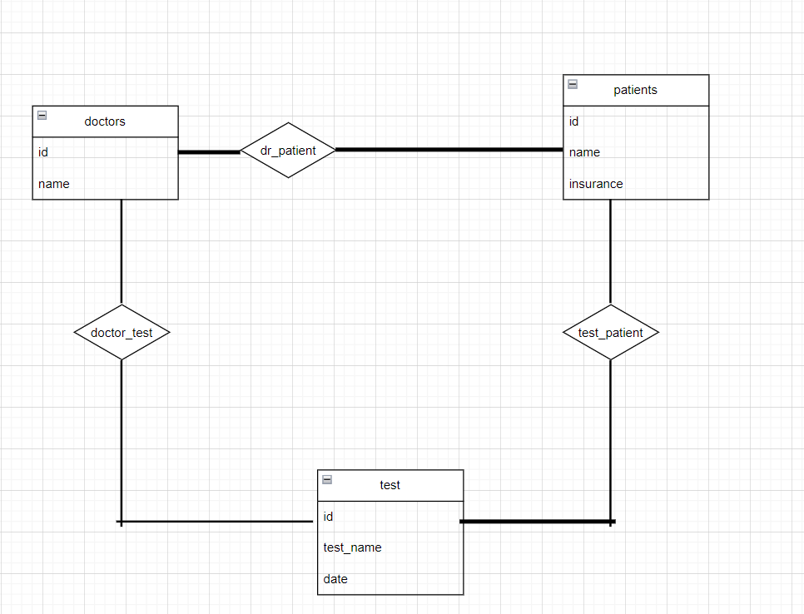
2

Slide 3
3
A weak entity has no primary key, a weak entity is depend on the attributes from the strong entity. It can convert to a strong entity by adding a primary key to a weak entity.

Slide 4
4
(i) select e.ID, e.person_name
From employee as e natural join works as w natural join company as c
(ii) Select e.ID, e.person_name from employee as e natural join manages as m inner join employee as c on c.ID = m.manager_id
Where c.street = e.street and c.city = e.city
(iii) Select e.ID, e.person_name from employee as e natural join works as w inner join
(select company_name, ave(salary) as ave_salary from works
Group by company_name) as d on
w.company_name= d.company_name
Where d.ave_salary< w.salary

Slide 5
4(b)
The dept_name attribute appears both in course and instructor. After the natural join, we get the result of an instructor teaches a course in his or her department.

